Slide 1
Glynn County Board of
Commissioners
Confidential
2020 Open Enrollment

Slide 2
Employees’ Responsibility
• Read Open Enrollment Materials
• Update your personal information and check beneficiaries
• Complete your enrollment by going on the on- line enrollment system, seeing an enroller or calling the service center between Monday, October 14th and 11:59pm on November 1st NO EXCEPTIONS!!
• Check your January payroll deductions

Slide 3
Qualifying Life Event
Marriage
Divorce
Birth of Child
Loss of other coverage
Loss of dependent status
You have 31 days from the date of the Qualifying Life Event to notify Human Resources of the change and provide them with appropriate documentation.

Slide 4
Enrollment Guidelines
To add someone to your benefits you have to
provide the following documentation:
Marriage Certificate
Birth Certificate
Date of Birth
Social Security Numbers

Slide 5
ShawHankins Acquired by NFP
ShawHankins, was recently acquired by NFP. NFP is an insurance industry leader with more than 5,000 employees and 250+ offices across the United States. As one of the largest benefits brokers in the nation.
While the company name will change, exceptional service remains the priority for the ShawHankins/NFP team. The service team, enrollment portal, contact numbers and office locations will not change. However, they will now have even greater ability to effectively serve you.

Slide 6
Changes for 2020
• Dental is changing from Anthem BCBS to Ameritas
and we are adding a third plan
• Vision is staying with Eyemed but we are increasing the frames allowance
• Ancillary products (critical illness, accident and permanent life) are changing from Aflac to Unum
• New Sydney App with Anthem so you can
access your medical info on the go

Slide 7
Benefit Resource Center
www.shawhankinsbenefits.net/glynncounty/

Slide 8
Enrollment Portal
How to Enroll:
www.glynncounty.bswift.com
Disable pop-up blocker
Username – first letter of your first name, last
name and your employee ID number
Password is the last four digits of your social security number – you will be prompted
We reset passwords every year

Slide 9
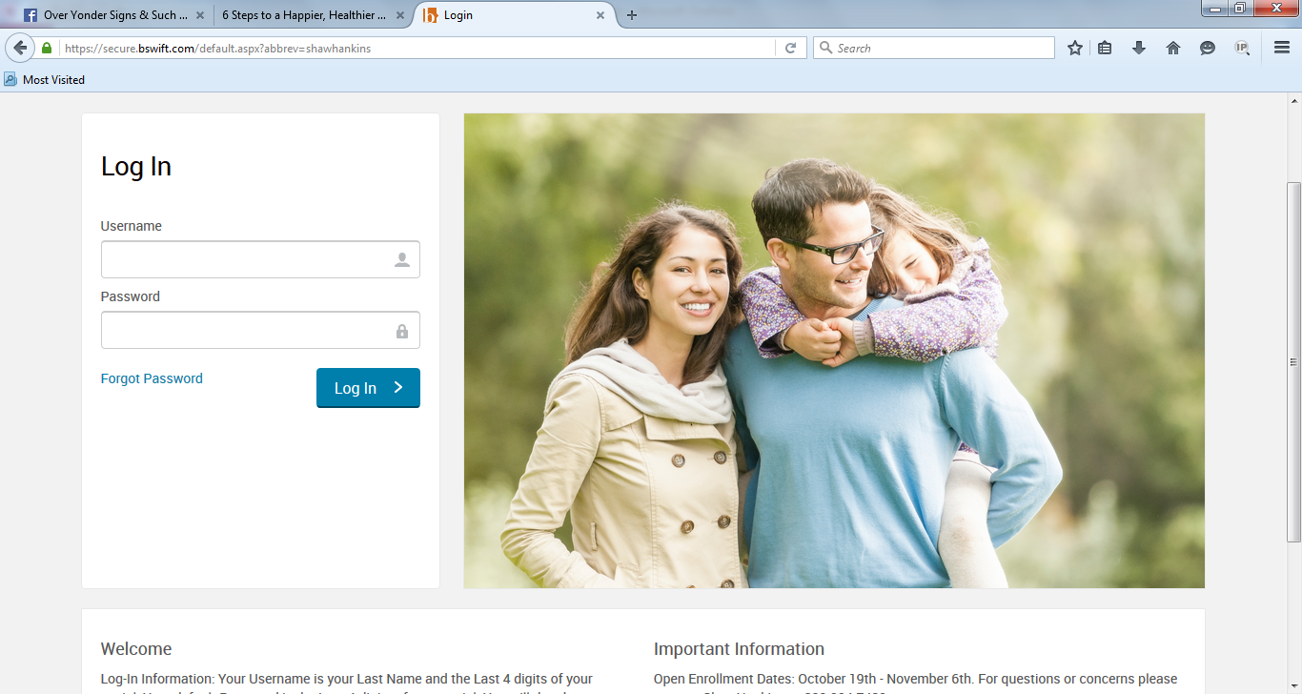
Enrollment Portal

Slide 10
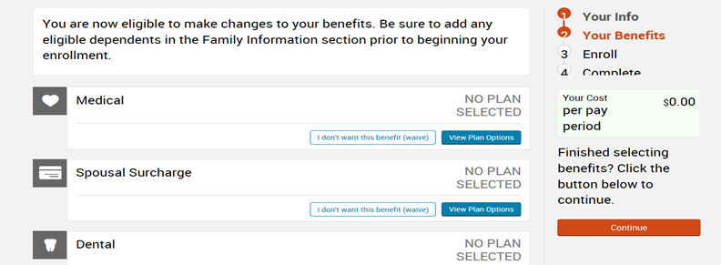
Completing Enrollment

Slide 11
Enrollment Complete

Slide 12
Medical Insurance
You still have two medical plans to choose from
with Anthem Blue Cross and Blue Shield.
In-network provider: Blue Open Access POS
should be used in the state of Georgia
Out-of-state provider: Blue Choice PPO
should be used outside of Georgia
Employees will receive new medical cards

Slide 13
$750 Deductible Plan
$750 in network and $1,050 out of network deductible
Family in network $2,250 out of network $3,150
80%/20% Coinsurance – No Change
Primary Care Visit - $30.00
Specialist Visit Copay - $40.00
Urgent Care - $30.00
ER Copay - $150 Copay then 80%/20%
Annual Maximum out of Pocket for Medical and RX
In-Network $5,500 individual and $10,000 family

Slide 14
$1,000 Deductible Plan
$1,000 in network and $2,000 out of network deductible
Family in network $3,000 out of network $6,000
80%/20% Coinsurance – No Change
Primary Care Visit - $40.00
Specialist Visit Copay - $50.00
Urgent Care - $65.00
ER Copay - $150 Copay then 80%/20%
Annual Maximum out of Pocket for Medical and RX
In-Network $7,350 individual and $14,700 family

Slide 15
Labs
In Georgia – Labcorp
Out of Georgia – utilize lab that is in the same network as prescribing physician

Slide 16
Prescription Coverage
RX Calendar Year Deductible Waived for Tier 1 | $50 Per Member
Retail Pharmacy 30 Day Supply
 | $15
Tier 1 – Generic
Tier 2 – Preferred Brand | $30
Tier 3 – Non-Preferred Brand | $50
Tier 4 – Specialty Drugs | 10% of Rx Cost
Mail Order 90 Day Supply
 | $25
Tier 1 – Generic
Tier 2 – Preferred Brand | $50
Tier 3 – Non-Preferred Brand | $85
Tier 4 – Specialty Drugs | 10% of Rx Cost

Slide 17
Payroll Deductions for $750 Plan
 | Wellness | Non Wellness | Wellness | Non- Wellness
 | Monthly | Monthly | Bi-Weekly | Bi-Weekly
Employee Only | $91.00 | $141.00 | $42.00 | $65.00
Employee + 1 | $193.00 | $243.00 | $89.00 | $112.00
Family | $234.00 | $284.00 | $108.00 | $131.00

Slide 18
Payroll Deductions for $1,000 Plan
 | Wellness | Non Wellness | Wellness | Non- Wellness
 | Monthly | Monthly | Bi-Weekly | Bi-Weekly
Employee Only | $76.00 | $126.00 | $35.00 | $58.00
Employee + 1 | $158.00 | $208.00 | $73.00 | $96.00
Family | $191.00 | $241.00 | $88.00 | $111.00

Slide 19
Sydney Mobile App
Download the Sydney app from the App Store
Benefits and Claims Information
Member Services
Wellness Resources
Find Care and Check Costs
Digital ID Cards
Get Alerts and Reminders

Slide 20
Anthem Enhanced Benefits
Anthem will now offer to cover Applied Behavioral Analysis (ABA) treatment for autism, without benefit limits, but with precertification/clinical review provided.
Hospice benefits are being expanded to members with life expectancy of up to 12 months and allowing members to take advantage of hospice support services, even while undergoing disease modifying treatments. The expanded hospice benefit helps ensure appropriate members can access services and support from hospice professionals without first having to make difficult decisions to end disease-modifying treatments.

Slide 21
Telehealth
•Teladoc - 24/7 access to physicians at NO COST for all family members. Common Conditions include – Cold, Flu, Bronchitis, allergies, poison ivy, pink eye, UTI, Respiratory infection and sinus
•Doctors Online -24/7 access to physicians though email or smartphone
•Health Advocacy -Help navigate through insurance and healthcare systems. Locate doctors, hospitals, pharmacies to help employees make informed decisions
•Medical Bill Saver - Skilled negotiators will attempt to negotiate additional discounts for lower out of pocket costs.

Slide 22
Employee Assistance Program
Six free counseling sessions for all employees and eligible dependents on the health plan
Emotional Well-being
Relationships/Parenting
Financial Education
Legal Matters
Personal/Professional Growth
www.espyr.com
Password: Glynn
Telephone - 800-269-0816

Slide 23
Dental - Ameritas
Benefits |  | Low Plan | High Plan | Network Value Plan
Annual Deductible | Applies to Basic and Major Services | $50/$150
Preventive | Cleanings, Exams, Fluoride for Children, Sealants, Etc. | 100%
Basic | Amalgams, Anesthesia, Oral Surgery, Root Canals & Other Procedures | 80%
Major | Crowns, Dentures, Bridges, Onlays | Not Covered | 50% | 50%
Annual Maximum |  | $750 | $1,250 | $1,750
Orthodontia |  | Not Covered | 50% | 50%
Lifetime Maximum | Orthodontia | N/A | $1,000 | $1,000

Slide 24
Dental Payroll Deductions
 | Low Plan |  | High Plan |  | Network Value Plan
 | Monthly | Bi-Weekly | Monthly | Bi-Weekly | Monthly | Bi-Weekly
Employee | $24.35 | $11.24 | $33.54 | $15.48 | $28.96 | $13.37
Employee + Spouse | $48.70 | $22.48 | $67.28 | $31.05 | $57.98 | $26.76
Employee + Child(ren) | $36.13 | $16.68 | $54.80 | $25.29 | $48.48 | $22.38
Family | $65.63 | $30.29 | $95.25 | $43.96 | $79.98 | $36.91

Slide 25
Vision - Eyemed
Benefit Highlights | Network Providers | Non-Network Providers
Eye Exam- Every 12 months | $10 co-payment | Up to $40
Frames-Every 12 months | $150 allowance Discount over $150 | Up to $91
Lens-Every 12 months | $15 co-payment single, bifocal, trifocal, Standard Progressive Lens $80 | Reimbursements of $30 for single, $50 for bifocal, $70 for trifocal
Contact Lens-Every 12 months (in lieu of lenses for glasses) | $130 allowance or Paid in full if medically necessary | Up to $130
Laser Vision Correction- Once per lifetime | 15% discount of retail | N/A

Slide 26
Vision Payroll Deductions
 | Monthly | Bi-Weekly
Employee | $8.14 | $3.76
Employee + Spouse | $14.26 | $6.58
Employee + Child(ren) | $17.12 | $7.90
Family | $21.19 | $9.78

Slide 27
Flexible Spending Account
Flexible Spending Account (FSA)
Unreimbursed Medical Spending Account
Set aside as much as $2,700
Deductibles, co-payments, co-insurance, vision, dental
May rollover up to $500 in unused healthcare FSA funds
to next plan year
Dependent Care Spending Account
Up to $5,000 if head of household or are married filing
joint return
Or up to $2,500 if you are married filing a separate return
Note: You must re-enroll in this benefit if you wish to keep it for 2020

Slide 28
Employer Paid Group Life Insurance - MetLife
Employee = 1X Annual Earnings
Spouse= $5,000
Child= $5,000
The county provides this benefit at no cost to you.

Slide 29
Voluntary Term Life - MetLife
Employee Amount | 5x Salary or $500,000 ($10,000 increments)
Employee Guaranteed Issue Amt | $200,000 as a new hire
Spouse Amount | 50% of Employee in $5,000 increments
Spouse Guaranteed Issue Amt | $50,000 as a new hire
Child Amount | $1,000 increments to $20,000
Child Guaranteed Issue Amt | $20,000 as a new hire
Annual GI Increase | 1 increment up to GI Amount

Slide 30
Short Term Disability - MetLife
Benefit:
Elimination Period:
60% to $2,000 in weekly benefits
Accident 0 Days
Sickness 7 Days
26 Weeks
Benefit Period:
Employees are required to exhaust sick leave before STD benefits will start
Check your sick leave balance to see if you need STD
Workers Compensation is excluded – only if you are not receiving 60%
If you declined this coverage in the past and want to add now, you must complete an evidence of insurability form and be approved for coverage

Slide 31
Long Term Disability - MetLife
Employer Paid Long Term Disability
60% of Salary to max $5,000 Monthly Benefit Elimination Period - 180 Days
The county provides this benefit at no cost to you.

Slide 32
Whole Life - Unum
Benefit Maximum Employee Spouse Child | $300,000 $75,000 $25,000
Paid Up Option | Payable to age 120 with Paid up Option at age 70
Guaranteed Issue Employee Spouse Child | $18 Weekly Premium $3 Weekly Premium $25,000
Guaranteed Interest Rate | 4.5%
Added Benefits | Waiver of Premium Long-Term Care Rider
Optional Benefits | Spouse or Child Standalone Plan LTC Restoration Benefit LTC Continuation Benefit

Slide 33
Critical Illness - Unum
Rating | Attained Age
Benefit Amount Employee Spouse Child(ren) | $10,000, $20,000 or $30,000 Up to 50% of Employee Amount Up to 50% of Employee Amount
Guaranteed Issue | $30,000 employee 50% Spouse or Child
Recurrence Benefit | Payable at 100%
Benefit Reduction | None
Pre-Existing Conditions | None
New Employee Waiting Period | 30 Days

Slide 34
Accident - Unum
Emergency and Initial Care
 | $125
Doctor’s Office Visit
Emergency Room Treatment | $250
Diagnostic Exam | Up to $400
Follow-Up Doctors Visit | $75
Hospitalization
 | $1,200
Admission
ICU Admission | $1,200
Hospital Stay Daily Rate | $350 per day
ICU Daily Rate | $350 per day
Maximum Benefit Period | 365 days
Lacerations | Up to $600
Surgery | Up to $1,500
Travel Personal Medical Travel Lodging (Up to 30 days per acc) | $200 $250 per day

Slide 35
Questions
NFP Service Center
1-800-994-7429
nfpsecustomerservice@nfp.com
Cindy Kennedy, Sr. Account Manager
1-678-535-6354
cindy.kennedy@nfp.com

Slide 36
NFP.com

